Slide 1
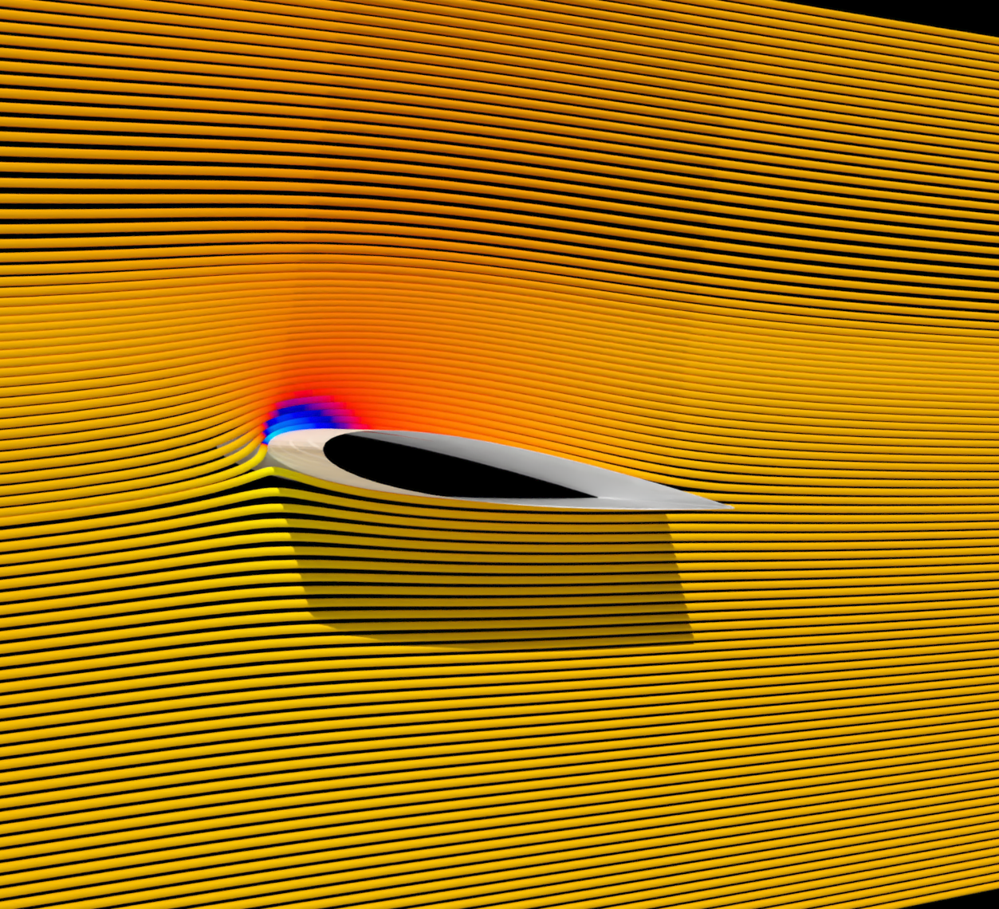
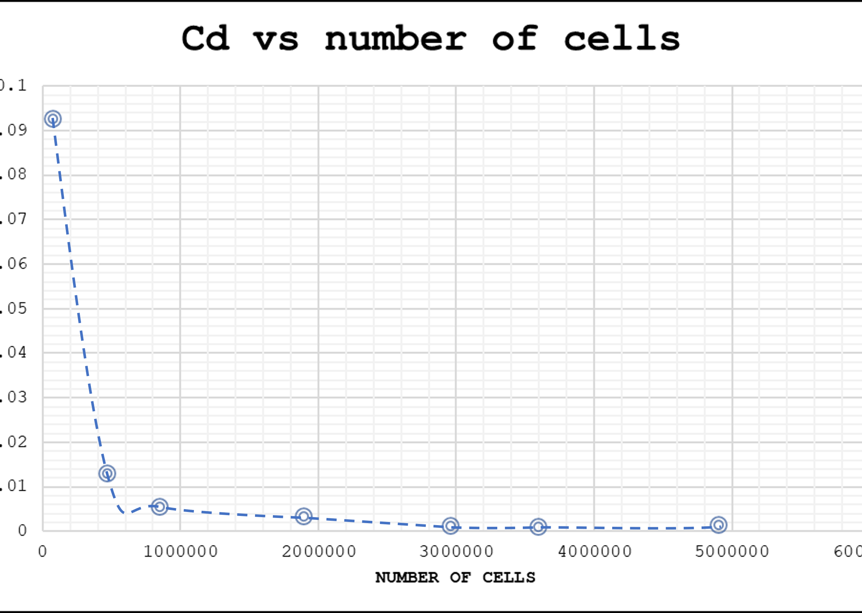
OpenFOAM Mesh Refinement Study
naca0012 at 8° α

Slide 2
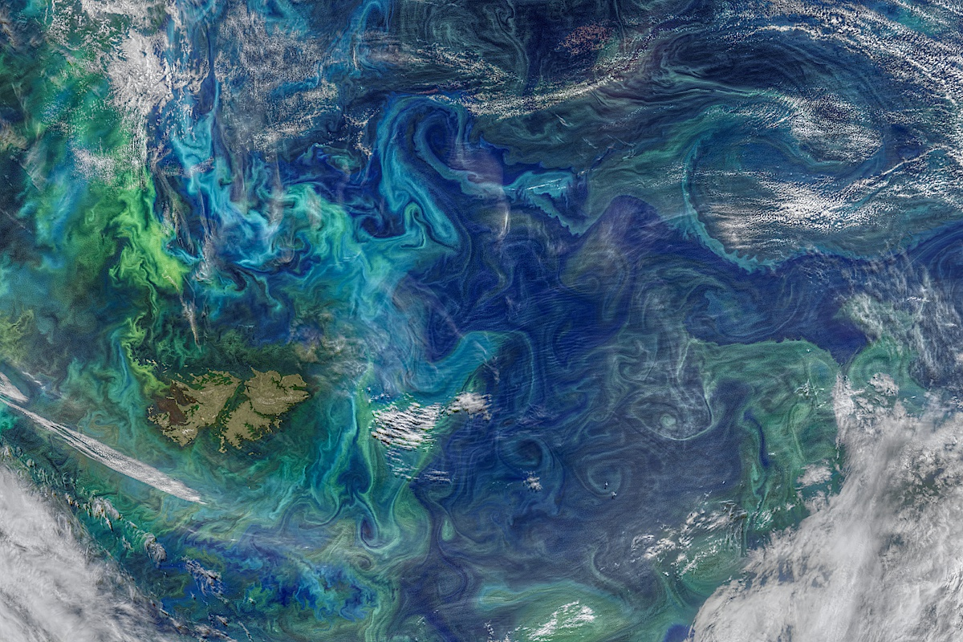
Project Setup
Meshing, Simulation, Post Processing

Slide 3
Solver: simpleFoam
Simulation Type: RAS
RAS model: KOmegaSST
Iterations: 1000
Parallel: 6 cores
Time Scheme: Steady State
Transport Model: Newtonian
Mesh: blockMesh and snappyHexMesh
Post Processing: ParaView and Excel

Slide 4
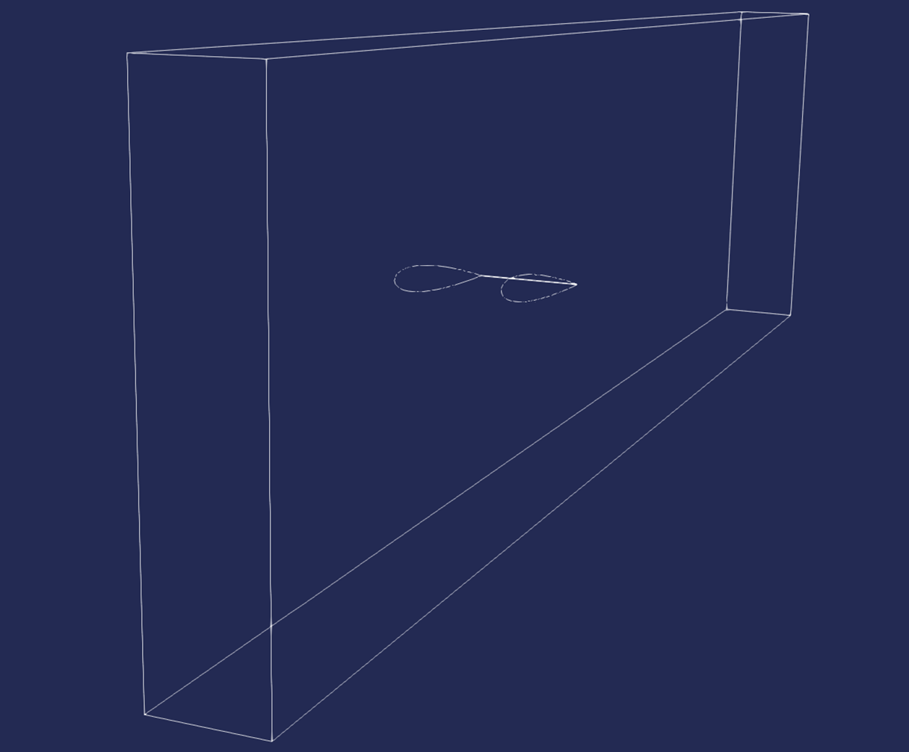
Boundary Conditions

Slide 5
No Slip Wall

Slide 6
Inlet

Slide 7
Outlet

Slide 8
Slip wall

Slide 9
Slip wall

Slide 10
Slip wall

Slide 11
Slip wall

Slide 12
Results

Slide 13
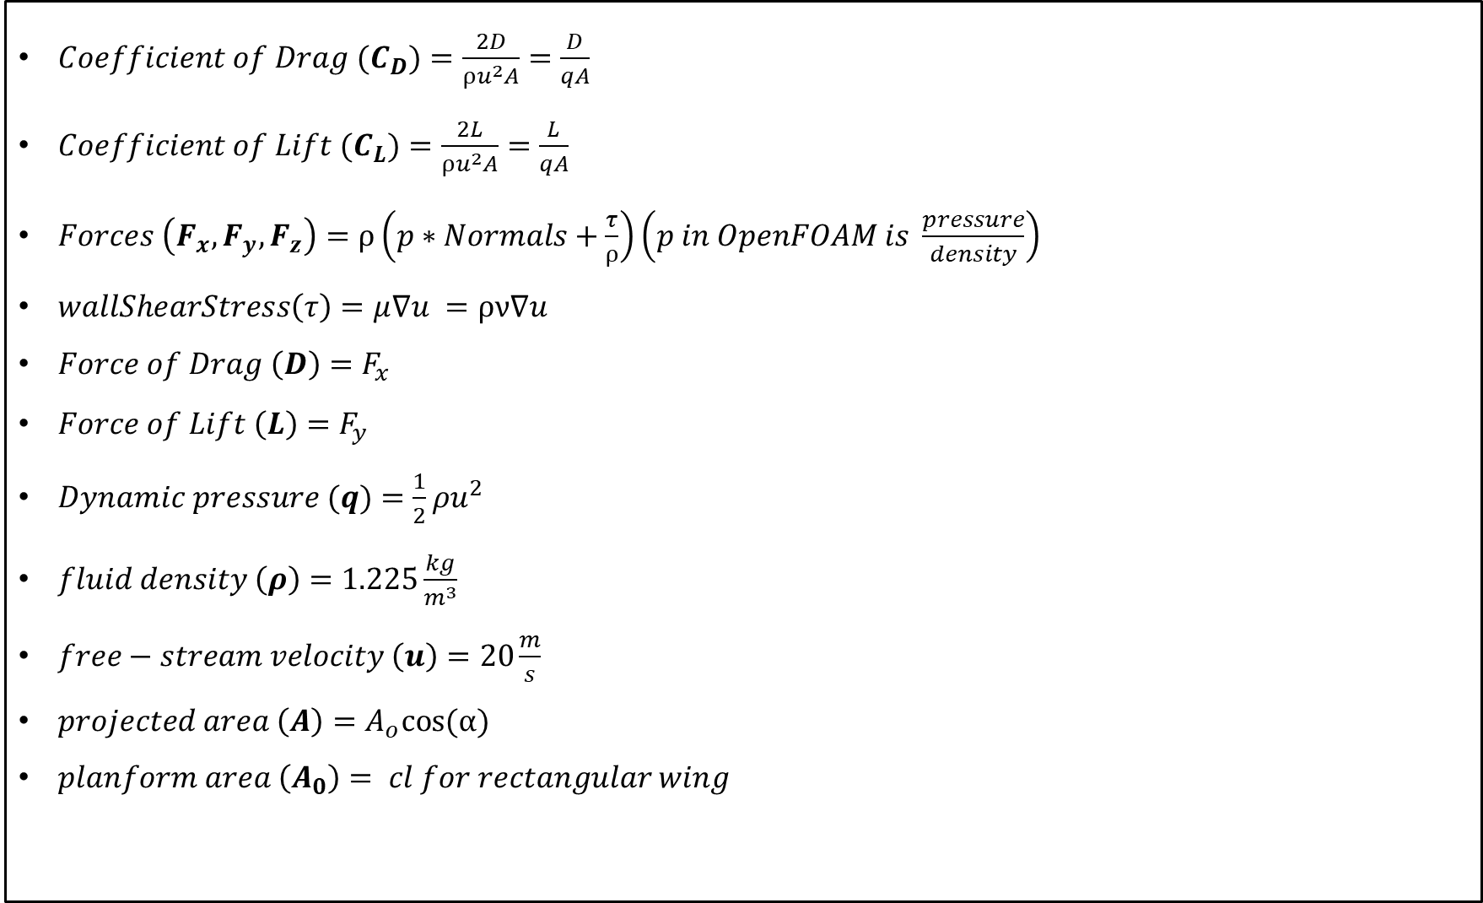
$Coefficient of Drag (C_{D})=\frac{2D}{ρu^{2}A}=\frac{D}{qA}$
$Coefficient of Lift (C_{L})=\frac{2L}{ρu^{2}A}=\frac{L}{qA}$
$Forces \left(F_{x}, F_{y},F_{z}\right)=ρ\left(p∗Normals+\frac{τ}{ρ}\right)\left(p in OpenFOAM is \frac{pressure}{density}\right)$
$wallShearStress\left(τ\right)=μ∇u =ρν∇u$
$Force of Drag \left(D\right)=F_{x}$
$Force of Lift \left(L\right)=F_{y}$
$Dynamic pressure (q)=\frac{1}{2}ρu^{2}$
$fluid density \left(ρ\right)=1.225\frac{kg}{m^{3}}$
$free−stream velocity \left(u\right)=20\frac{m}{s}$
$projected area \left(A\right)=A_{o}cos⁡(α)$
$planform area \left(A_{0}\right)= cl for rectangular wing$

Slide 15
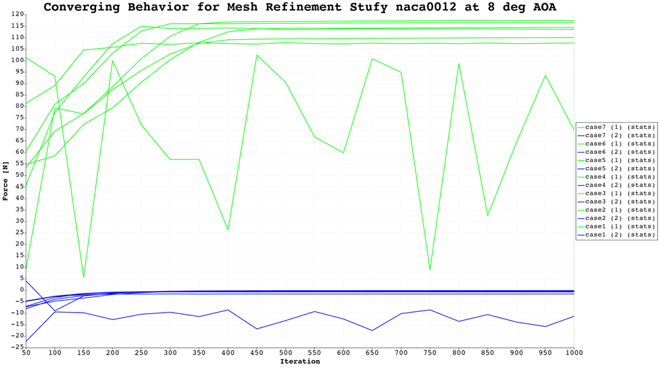

Slide 16
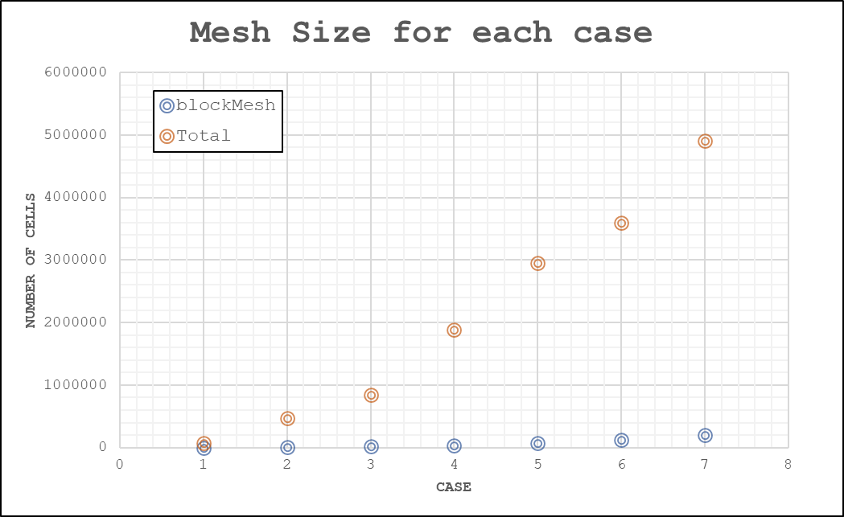

Slide 17
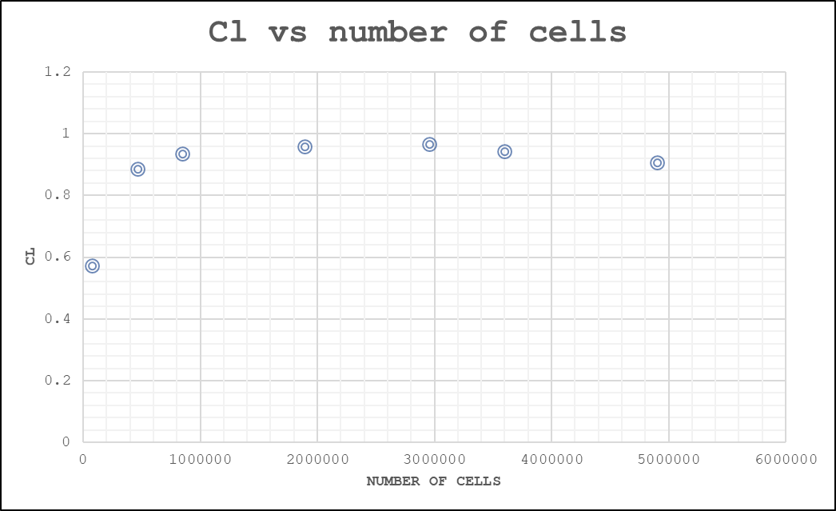

Slide 18
